Slide 1
Lab 02 – Building a Custom Connector from Scratch 💪

Slide 2
Agenda
Scenario: Event Management
Base Setup / Solution
Parts of a connector
Start from B

Slide 3
Scenario
Let‘s connect with the Nordic Summit Event Management!

Slide 4
Nordic Summit ❤️ Power Platform

Slide 5
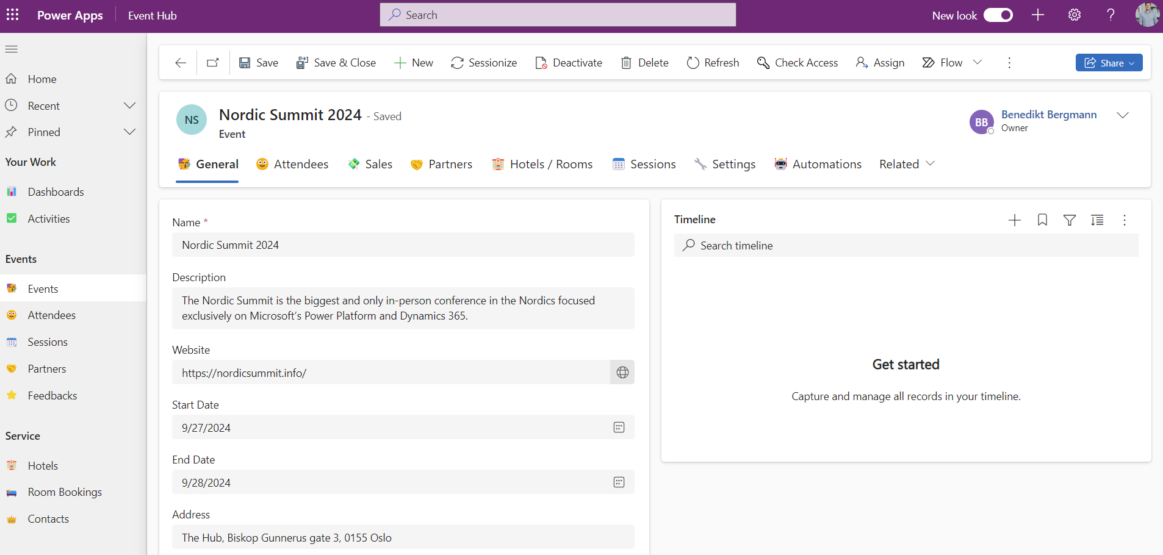
App Model Driven
Attendee Management
Sessions / Speaker
Hotel Room Bookings
Partner Management
Sales
Feedback
And more!

Slide 6
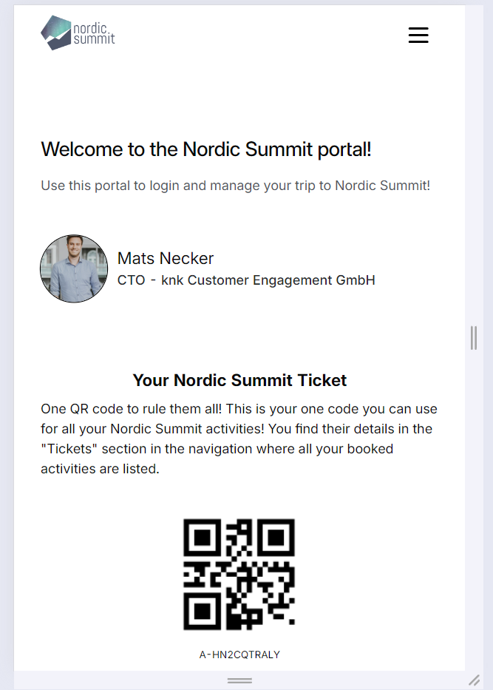
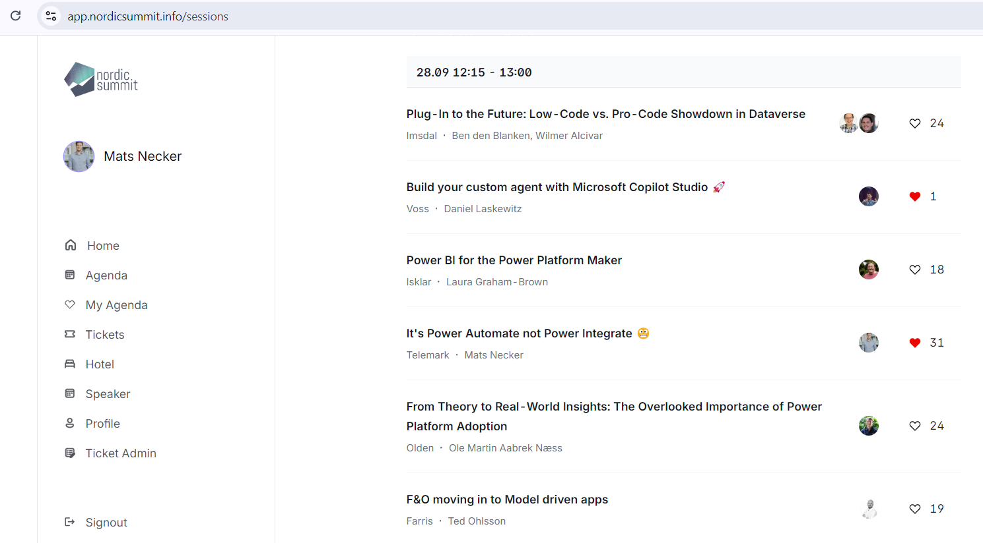
App Phone

Slide 7





Behind the scenes
Nordic Summit uses Power Platform + Azure for their Event Management
Trigger Build
Consume
Get Data
Dataverse
Static Web App
M365 Tenant
Azure
API Management
External Users

Slide 8



Behind the scenes
We use a Custom Connector to connect with their API
Get Data
Consume
Dataverse
Static Web App
M365 Tenant
External Users
Azure
API Management
Custom Connector
Workshop Tenant

Slide 9
Step by step: Build a connector
Read the docs / know the API you want to build the connector for
Start in one of the products (Power Apps, Power Automate or Logic Apps)
Set up the authentication
Define the operations (triggers / actions) for your connector
Add code if needed (for now, C# code is supported)
Save and test your connector

Slide 10
Ways to create a new custom connector
Create from blank
Create from Azure Service (Preview)
Import an OpenAPI file
Import an OpenAPI from URL
Import a Postman collection
Import from GitHub
Lab 02!

Slide 11
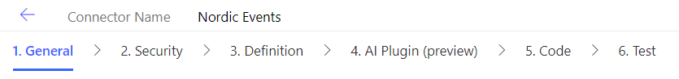
The process

Slide 12
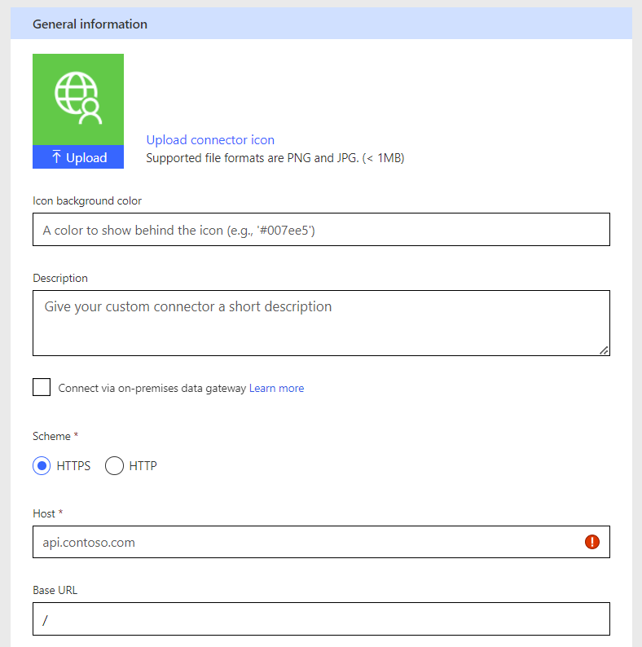
Base Setup - URL
🙂
Will be base url for all requests
Can not be overwritten by request*
https://apim-dhino-fetch-test.azure-api.net/001

Slide 13
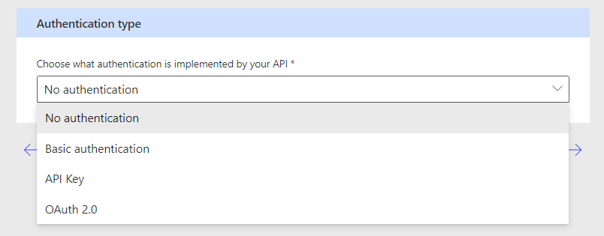
Different Authentication Methods
Depends on your API – if it has a different one it will be time to get creative

Slide 14

DEMO TIME!

Slide 15
Lab 02 – Building a Custom Connector from Scratch 💪

Slide 16
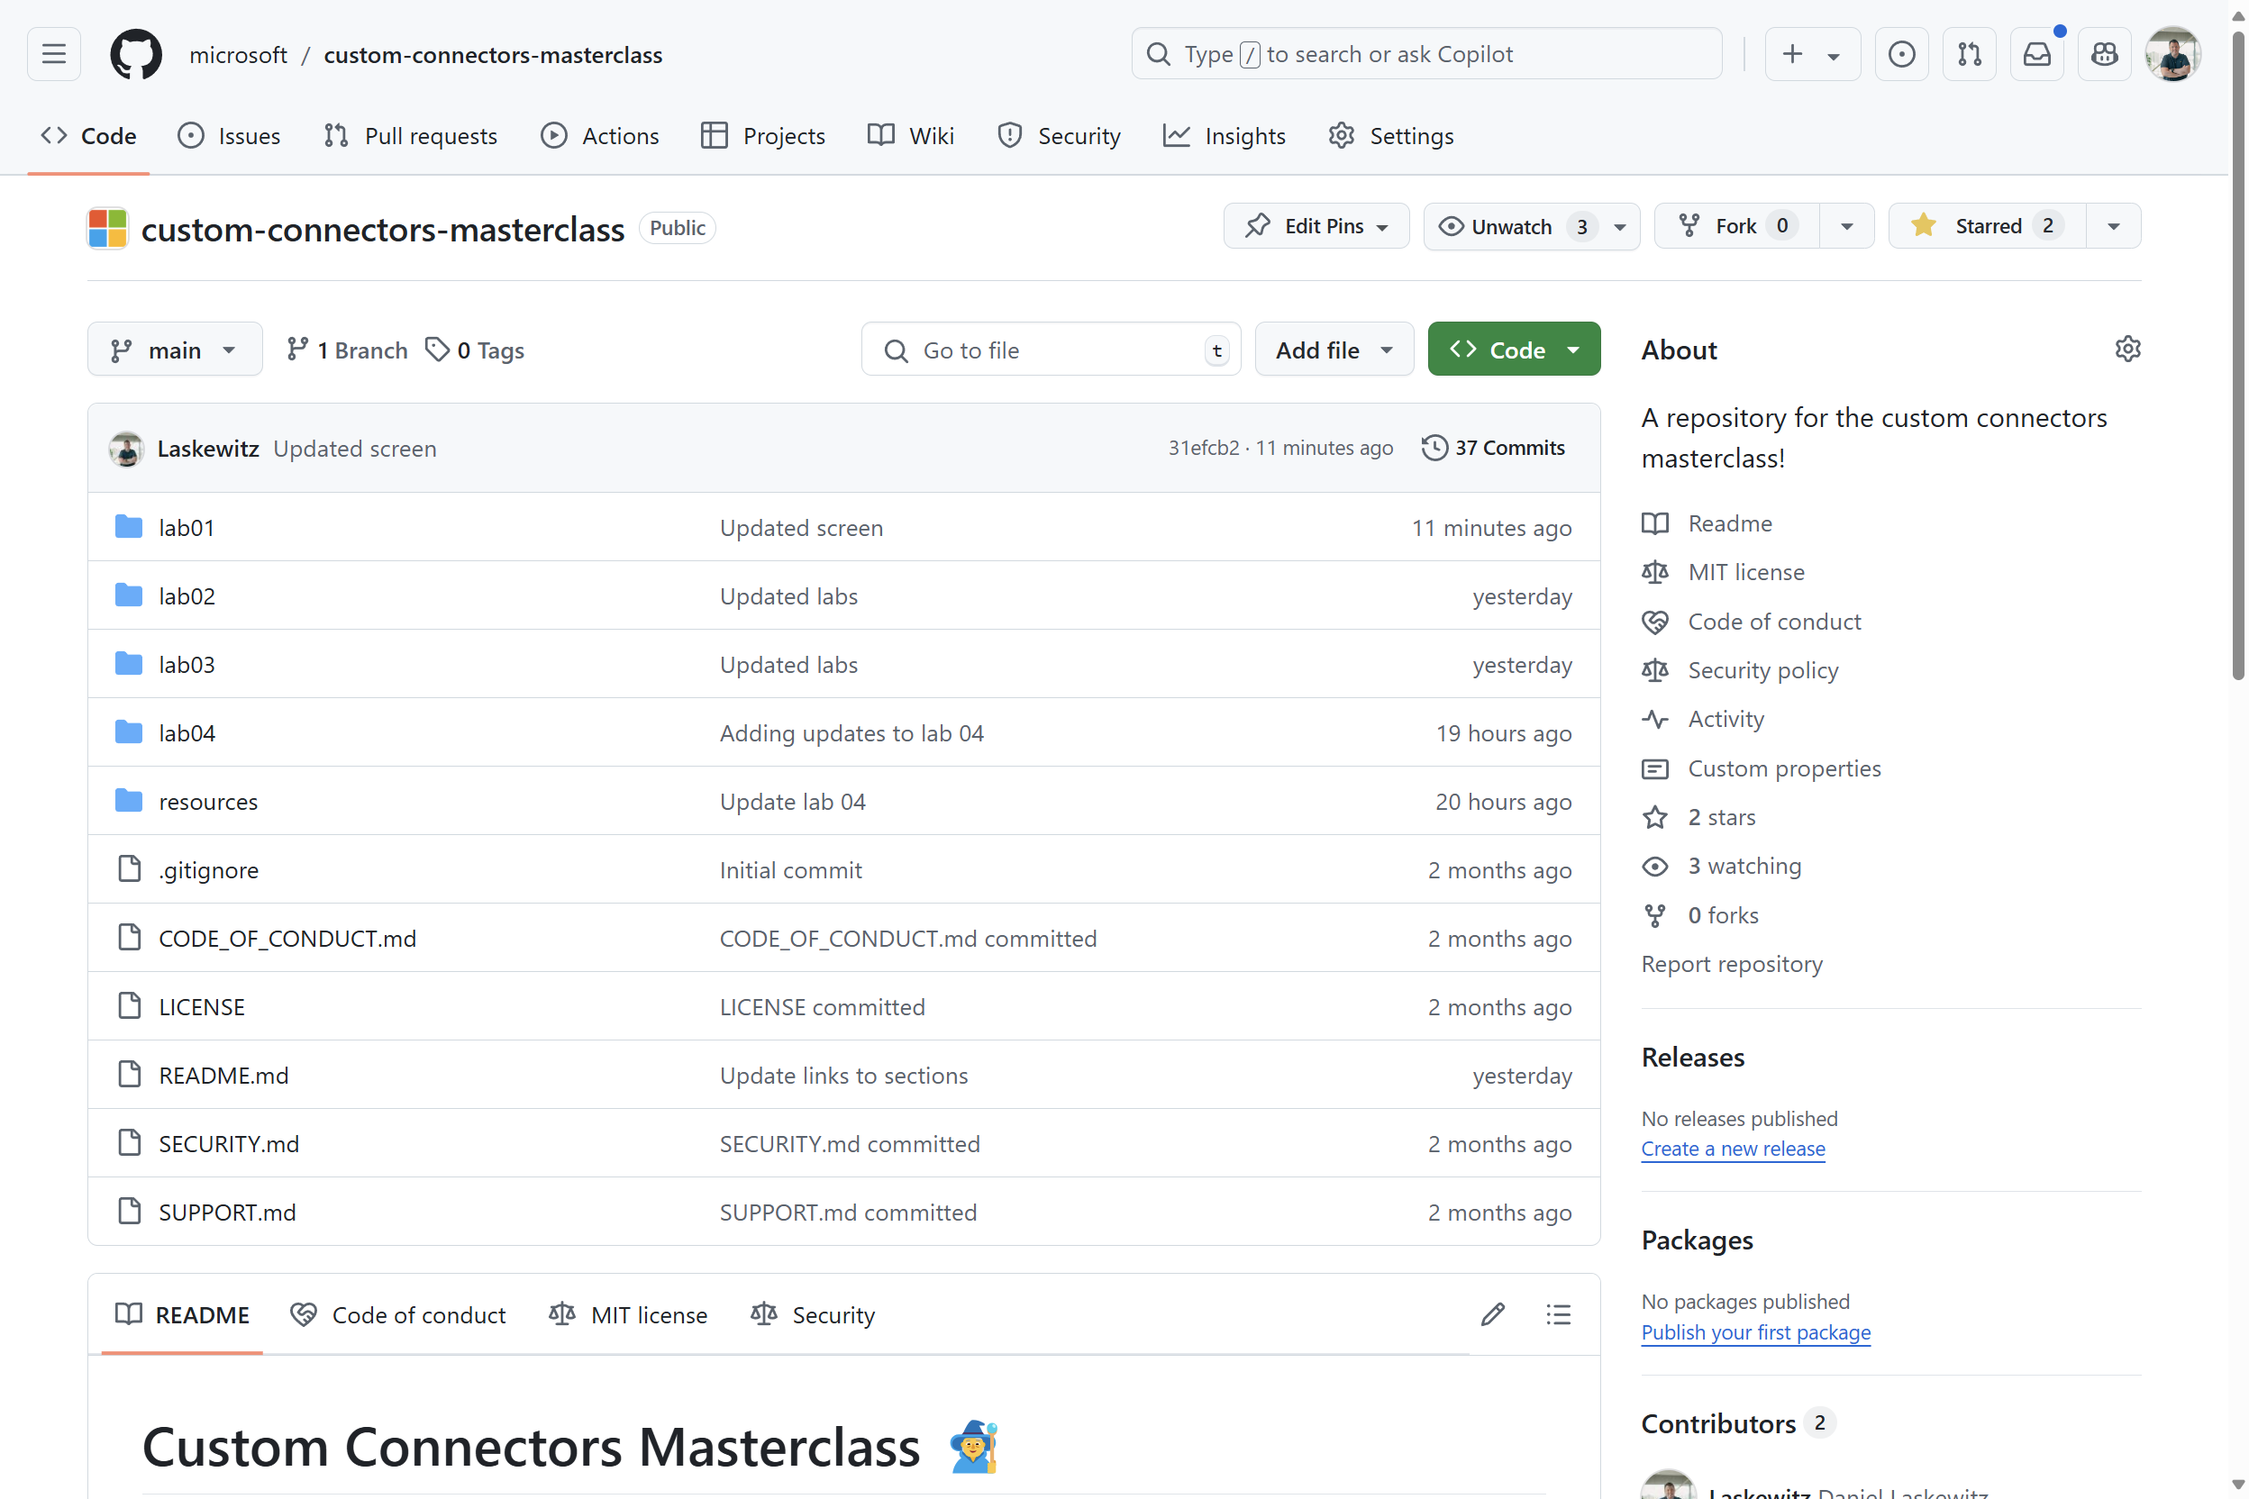
Lab environment
https://aka.ms/custom-connector-masterclass

Slide 17
Lab 02 – Building a Custom Connector from Scratch 💪
Create Solution
Create a connector in the solution
Setup authentication
Add simple operation (& test it)
Add operation with Parameters

Slide 18
Lab 02 – Wrap up
Questions?
Ideas?
Comments?

